Slide 2
Overview: The Ancient to Medieval World

Slide 3
Brainstorm:
What events/things could have lead to the fall of ancient civilizations and the beginning of the medieval world?

Slide 4
Overview: The Ancient to Modern World
What will we be covering:
The Fall of Rome and the beginning of the Dark Ages
Rise of Christianity and Islam
Trade/Discovery/Expansion
Scientific Revolution and the Enlightenment

Slide 5
Main Focus: Between the end of the ancient world (c. ad 500) and the beginning of the modern world (c. 1750), empires and civilisations rose and fell round the world, changing through contact with others.

Slide 6
Why it’s relevant today?
Studying the rise and fall of these civilisations helps us to understand changes in the world today, such as the growing importance of Asian powers.
Learning about the spread of Christianity and Islam, and their interactions both through peaceful trade and through violent conflict, gives us insight into relations between Muslims and Christians today.

Slide 7
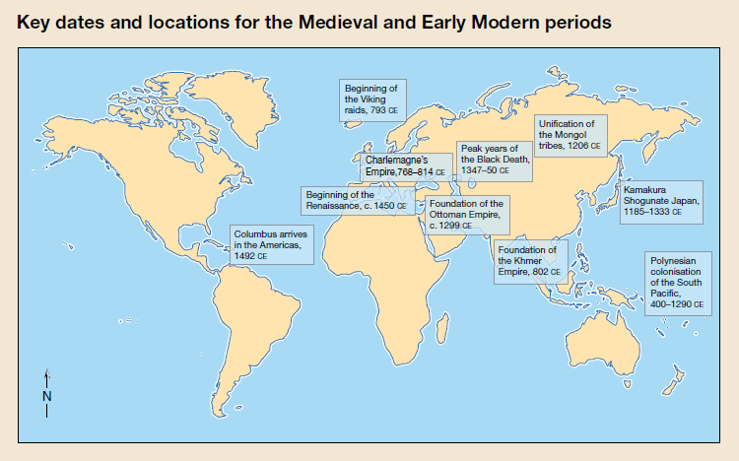

Slide 8
Year CE | Event
476 | Last Emperor of the western Roman Empire is overthrown
c.550 | Japanese adopt Buddhism and Chinese Script
570 | Birth of Mohammad, who becomes the prophet of Islam
793 | Vikings attack Lindisfarne, England
800 | Charlemagne is crowned Roman Emperor
c.1000 | Vikings settle at Vinland, Newfoundland
1095 | First European Christian Crusade
1206 | Temujin takes the title ‘Genghis Khan’ and Mongol tribes unify
1192-1867 | Shogunate Japan
1215 | Magna Carta is signed between King John and Barons in England
1271 | Kublai Khan, grandson of Genghis Khan, founds Yuan Empire in Beijing
1299 | Foundation of the Ottoman Empire
1347 | Black Death reaches the Mediterranean Sea
c.1450 | Beginning of the Renaissance in Italy
1453 | Turkish Ottoman Empire captures Constantinople and overthrows the Byzantine Empire
1492 | Christopher Columbus arrives in the Americas
1770 | Cook maps the East coast of Australia

Slide 9
Task – Handout: Map and Timeline
Glue in the map of key dates and locations under the heading of: Overview: The Ancient to the Modern World.
Create a timeline using the information on the previous slide. Please use a ruler and be a accurate as you can with placing dates - you may summarise
events.
C. 550 AD
c. 1000 AD
1206 AD
c. 1450AD
1492 AD
793 AD
1215AD
1299AD
476 AD
570 AD
800 AD
1095 AD
1192 AD
1271AD
11347 AD
1453 AD
1770AD

Slide 10
The Roman Empire:
What do you already know about Ancient Rome?
The Army
Roads & Trade
Buildings and Inventions
Gladiators
Emperors e.g. Caesar
It was the main power in Jesus’ day.
Notes:
Question: What problems could an empire that big face?

Slide 11
What contributed to the success of the Roman Empire?
The Roman Army was highly T_____________ and E___________.
Roman R___________ connected the various parts of the Roman Empire making T__________ and the movement of soldiers easier.
Resources from newly conquered areas and trade increased Rome’s W__________.
Rome learnt from the countries they C______________.
New D____________ improved standards of living
People in Rome were united and subdued through E____________.
Initially there was strong L_____________ and administration from Rome.

Slide 12
What contributed to the success of the Roman Empire?
The Roman Army was highly trained and effective.
Roman roads connected the various parts of the Roman Empire making trade and the movement of soldiers easier.
Resources from newly conquered areas and trade increased Rome’s wealth.
Rome learnt from the countries they conquered.
New developments improved standards of living
People in Rome were united and subdued through entertainment.
Initially there was strong leadership and administration from Rome.

Slide 13
Notes:
Roads: As Rome conquered more land, they also came to control trade and the resources of the new areas.
Trade and transport was made easier by extensive roads that the Romans built.
Buildings: The increased wealth meant that Rome was able to have many new developments.
Gladiators: The masses would be ‘entertained’ through lavish but grizzly shows often organised by senators to gain popularity.
Entertainment in Rome helped to keep the masses happy…

Slide 14
QUIZ!
First person that puts hand up and answers: 4 things that contributed to Rome’s success
Notes:
Question: What problems could an empire that big face?

Slide 15
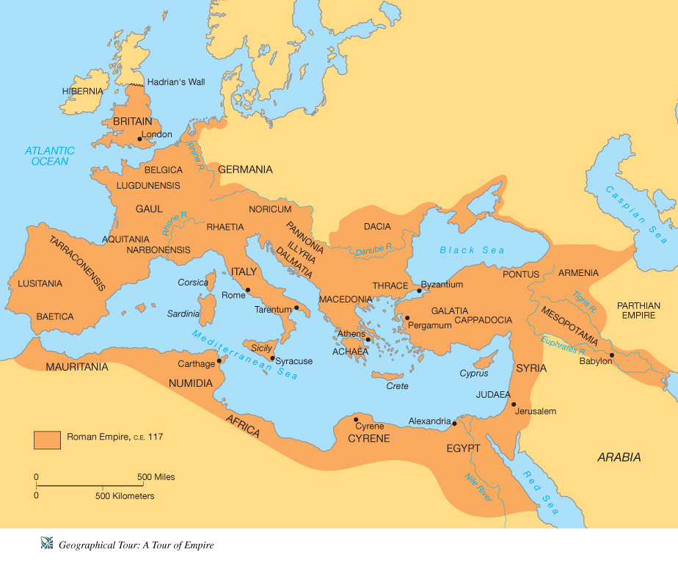
#1 The Fall of the Roman Empire
Question:
What problems could an empire that big face?
Rome was the most powerful empire the world had ever seen.
It’s architecture and aqueducts added to the prestige of the empire.
Notes:
Question: What problems could an empire that big face?

Slide 16
#1 The Fall of the Roman Empire
The empire was so massive and with so many traditions, languages, religions and cultures under one emperor, things began to get difficult to manage.
In order to manage the massive empire, Emperor Diocletian divided Roman empire into eastern and western empires that were governed by himself and his friend Maximian.
While it was manageable at first, it couldn't protect Rome and ultimately collapsed.

Slide 17
#1 The Fall of the Roman Empire
There are five areas that attributed to the eventual fall of Rome, and then an immediate cause.
Problems arose:
Politically
Economically
Militarily
Socially
Just remember:
PEMS

Slide 18
In your workbooks…
Under the heading of “#1 The Fall of Rome, draw up this table.
As we go through this PowerPoint, place words/phrases in the right column that suggest reasons for the fall of the Roman Empire.
Please don’t rule too far down the page, and don’t close the table off until we finish putting in the words!
Politically | Economically | Militarily | Socially

Slide 19
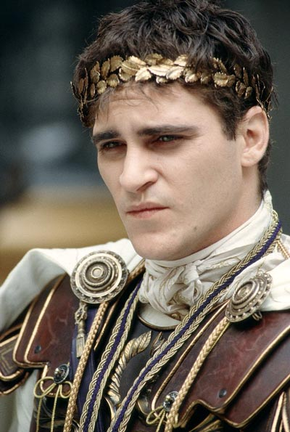
Politically
FACT: In 180 CE Emperor Marcus Aurelius died leaving his son, Commodus, to take control of Rome. Eventually, he became unpopular due to his lack of leadership skills, and became known as being ‘ridiculous’ within his empire – he led such a lavish lifestyle, that it led the imperial treasury almost bankrupt! He was poisoned by conspirators and then strangled in his own bed by his very own bodyguard! (Commodus from Gladiator
The size of Rome made difficult to govern, but ineffective and inconsistent leadership only served to magnify the problem.
The Praetorian Guard—the emperor’s personal bodyguards—assassinated and installed new leaders at will, and once even auctioned the spot off to the highest bidder!
Corruption and incompetence within the whole government meant this political situation would worsen
And due to this political contamination, civic pride disappeared and many Roman citizens lost trust in their leadership.
Notes:
The size of Rome made difficult to govern, but ineffective and inconsistent leadership only served to magnify the problem.
The Praetorian Guard—the emperor’s personal bodyguards—assassinated and installed new leaders at will, and once even auctioned the spot off to the highest bidder!
Corruption and incompetence within the whole government meant this political situation would worsen
And due to this political contamination, civic pride disappeared and many Roman citizens lost trust in their leadership.

Slide 20
Economically
Romans stopped conquering lands; flow of gold into Roman economy decreased.
Constant rise of taxes = rich people stopped paying taxes, more pressure on poor people.
Farmers lost land, unable to grow and sell crops, out of work (and famine)
People bought fewer goods, shops closed
Coins lost value: Less gold put in, people found out (caused inflation)
Inflation occurred: Rapidly rising prices. Money lost value because fewer taxes paid. (no taxes = no money = poor empire)

Slide 21
Militarily
Large territory = administrative and logistical nightmare.
Rome struggled to gather enough troops and resources to defend its frontiers from local rebellions and outside attacks.
As more and more funds were funneled into the military, maintaining the empire proved difficult, technological advancement slowed and Rome’s civil infrastructure fell into disrepair.
Emperor Hadrian built his famous wall just to keep the enemy at bay!
Notes:
Large territory = administrative and logistical nightmare.
Rome struggled to gather enough troops and resources to defend its frontiers from local rebellions and outside attacks.
As more and more funds were funneled into the military, maintaining the empire proved difficult, technological advancement slowed and Rome’s civil infrastructure fell into disrepair.
The spread of the Roman Empire began with the defeat of Carthage over three wars, called the Punic Wars. After 100 years of war, when the Romans eventually won, they burned Carthage to the ground and all signs of the city and its former power was eradicated.
Soldiers in the Roman army were expected to serve for 25 years and not get married.
Once they served 25 years, they got a pension and land to farm.
They were highly trained warriors who were well equipped with armour and weapons.
Winning campaigns brought lots of glory.
Countries that were defeated became a part of the Roman Empire and people from those countries could join the Roman Army.
Rome learnt from the countries that they
defeated and absorbed what they learnt into their
way of doing things.

Slide 22
Socially
Taxes were too great, many rich people stopped paying while others were threatened
Large number of people enslaved and soon Rome began relying on it’s slave labor for much of the economical success.
People were very poor, so crime rates increased causing social unrest.
Famine and Disease: There was not enough food to feed people and constant trade/interactions meant diseases could be carried all over the empire.

Slide 23
Causes of the Fall of Rome
Politically | Economically | Militarily | Socially
Office seen as a burden Military interfered Civil war Division of Empire | Poor harvests Disruption in trade Inflation Tax burden Gap between rich and poor | Threats in North Low funds for defense Decline in population | Decline in interests Low confidence Lack of Patriotism Rich/Poor contrast Decline in population
Immediate Causes = Barbarian Invasion!

Slide 24
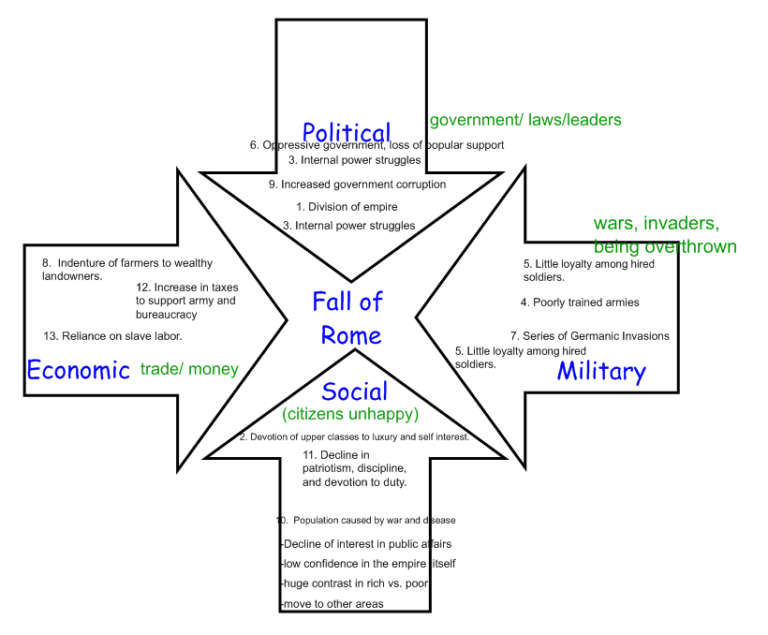

Slide 25
QUIZ! 1. What were the four main causes to the fall of Rome? AND list one example for each cause
Notes:
Question: What problems could an empire that big face?

Slide 26
Immediate Causes: Barbarian Invasion!
The West faced worse problems than the east that was far from invaders
From A.D. 376 to 476, huge numbers of Germanic tribes poured into Rome to get away from the fierce Huns
Attila the Hun was a powerful chieftain who swept through the west
After he died, Germanic tribes continued to invade and finally the west was no longer Rome
But the Eastern Roman empire will continue as the Byzantine Empire that will preserve Greek and Roman heritage.

Slide 27
Immediate Causes: Barbarian Invasion!
Threatened from all sides of its borders as well as experiencing internal difficulties, the might of Rome gradually dwindled until finally, the Roman Emperor of the Western Roman Empire, Romulus Augustus was deposed by the Germanic King, Odoacer on 4th September 476CE.

Slide 28
CONCEPT MAPPING
Create a concept map about the causes of Rome’s downfall.

Slide 29
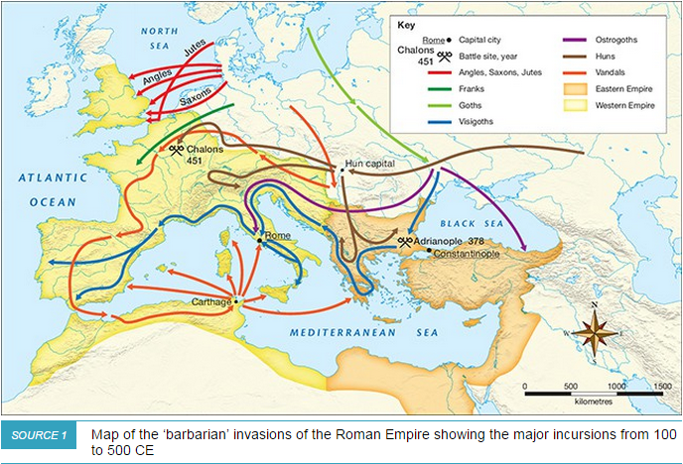
From Ancient to Medieval
While the fall of Rome did not happen over night, but rather over a number of years, many consider it’s fall to be the beginning of the Dark Ages.
Migration of barbarian tribes into Roman territory were not necessarily destructive, but they had their own culture and leaders – a step towards dissolving Rome.
The invasion of Barbaric tribes (Germanic tribes, the Huns and the Goths: Ostrogoths and Visigoths)

Slide 30
Write and answer the following questions in your books
What made the Roman Empire so powerful?
How were they able to extend their territory so far?
Why did the Empire split into two?
Why did the Roman Empire begin to decline?
Why did the Roman Empire collapse?

Slide 32
#1 The Fall of Rome: Links and Videos
https://www.youtube.com/watch?v=GylVIyK6voU What do you observe about the growth and decline of the Roman Empire? At what point in time do you think the Roman Empire collapsed?
https://youtu.be/3PszVWZNWVA
http://www.teachertube.com/video/horrible-histories-the-roman-report-with-bob-hale-290177

Slide 33
#2 The rise of Christianity and Islam.

Slide 34
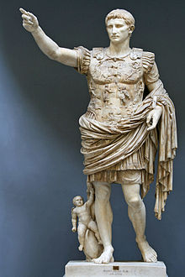
Jesus and the roman empire
Jesus was born during the reign of Caesar Augustus.
[Luke 2]
Augustus was the adopted heir of Julius Caesar. After Julius Caesar’s assassination, there was a period of political unrest until Caesar Augustus became the emperor.
Caesar Augustus’ reign was marked by a period of relative peace and prosperity.

Slide 35
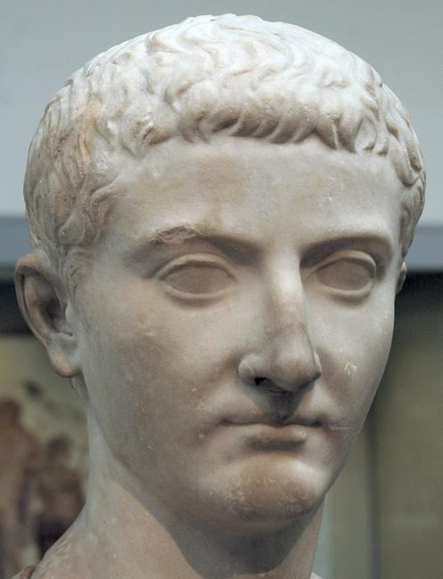
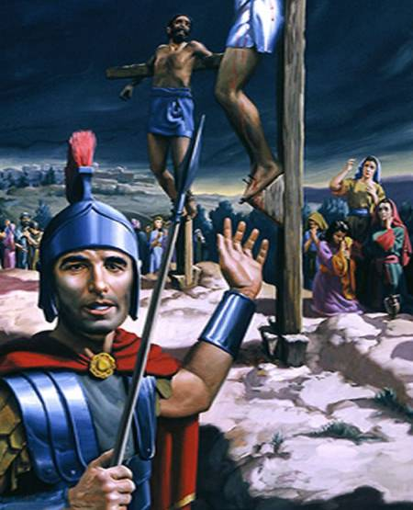
Jesus and the roman empire
Jesus was crucified during the reign of Tiberius Caesar.
Crucifixion was a punishment used by the Romans.
It was the most dishonourable death imaginable and reserved for the worst of criminals and slaves.
Roman citizens were usually exempt from crucifixion.
It was a horrendous way to die, hence the word, ‘Excruciating’.

Slide 36
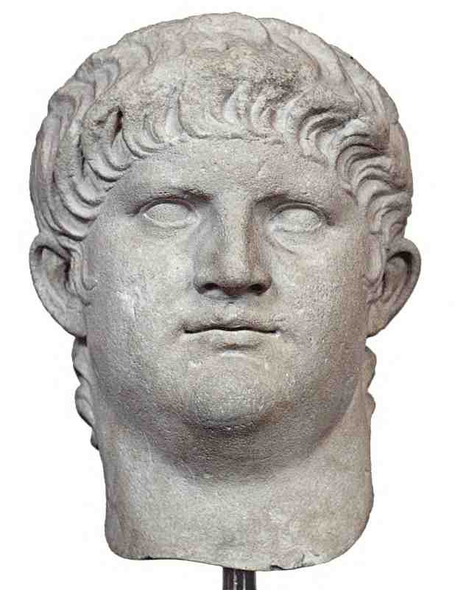
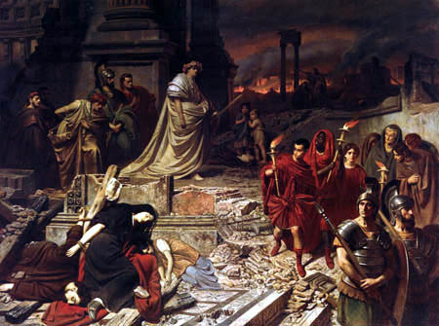
Emperor Nero & the early Christians
In 64AD, most of Rome was destroyed in ‘The Great Fire of Rome’
Most Romans believed that the fire was started by Nero as he tried to clear land in order to build himself a palace complex.
He is rumoured to have captured Christians, dipped them in oil and set them on fire to provide light in his garden at night time.
Nero was the Emperor between 54 and 68 AD
Most historians believe that it was during Nero’s reign that Peter and Paul were martyred.

Slide 37

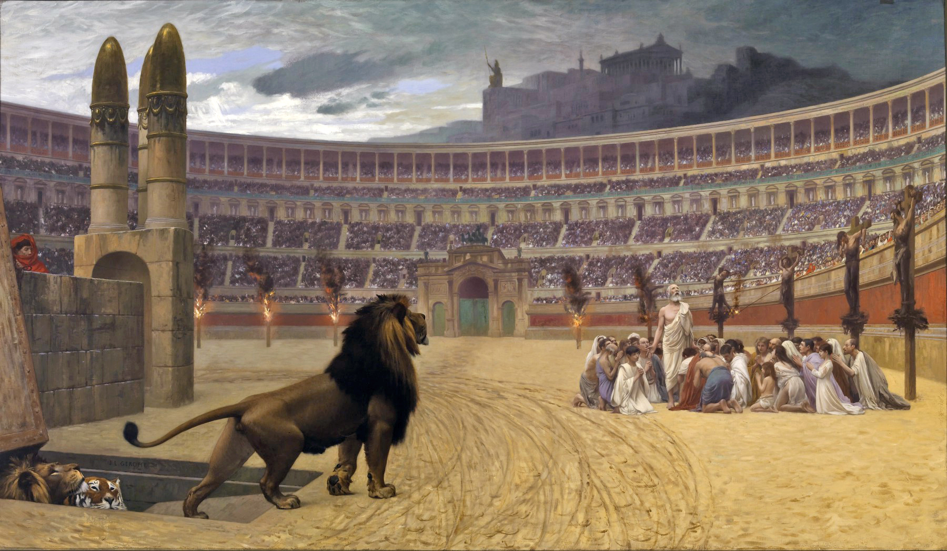
Christian persecution
As Rome fell into greater instability, many people tried to blame the Christians, who refused to make sacrifices to the Roman gods.
The worst persecution is believed to have occurred during Diocletian's reign. He made it against the law to be a Christian.
Christians were captured and fed to the lions in the Roman arenas as a form of entertainment.
https://en.wikipedia.org/wiki/Diocletianic_Persecution

Slide 38
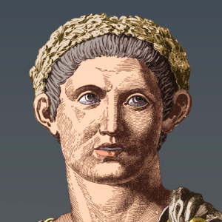
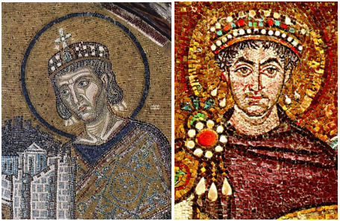
The Rise of Christianity
Emperor Constantine favoured Christians.
In 313AD, he and Emperor Licinius created an edict, called the ‘Edict of Milan’, making it no longer a criminal act to be a Christian. In fact it called on religious tolerance generally.
Later in his life, he declared that he himself was a Christian.
Emperor Constantine’s reign was a turning point in Christianity.
He returned property belonging to Christians that had been possessed during ‘The Great Persecution of Diocletian’.
He appointed Christians to high ranking positions in the Empire.
Emperor Constantine
Emperor from 306-337AD

Slide 39
The Rise of Christianity
Constantine created a new capital of the Eastern Roman Empire at Byzantium and later renamed it Constantinople.
Unlike "old" Rome, the city began to employ overtly Christian architecture, contained churches within the city walls and had no pre-existing temples from other religions.[17]
In order to fund these buildings, Constantine had to get his citizens to pay for it so he began teaching that the old religion of the Romans should be put aside and as a result, attendance at temples began to decline.
This would turn out to be the heart of the Byzantine Empire.

Slide 40
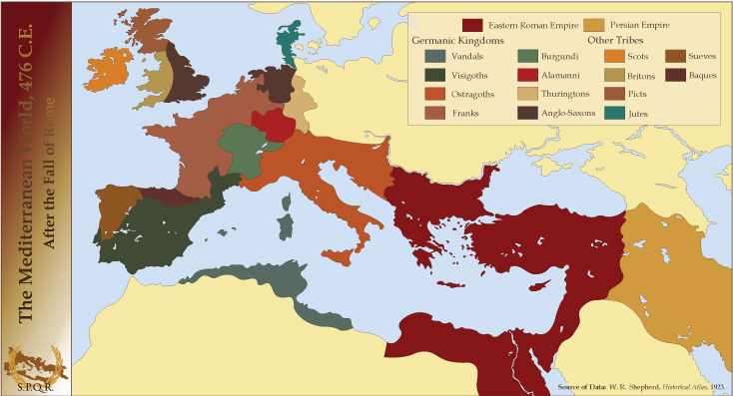
Notes:
http://www.acting-man.com/blog/media/2014/08/R-After-Rome.jpg [Access date: 29/07/15]

Slide 41
The Rise of Christianity
Once the Roman Empire fell, there were Roman Christians as well as Christians from other ‘barbarian’ tribes. They became missionaries who continued to spread the Good New of Jesus.

Slide 42
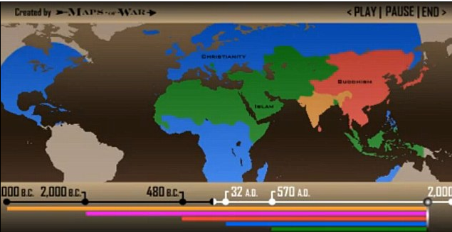
The spread of religions around the world
http://www.dailymail.co.uk/news/article-2512088/Watch-major-religions-conquered-entire-world-5-000-years--90-seconds.html#v-2859889391001

Slide 43
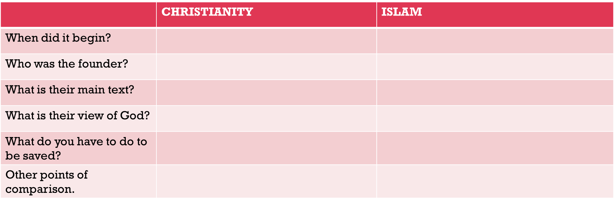
Comparison between Christianity and Islam
Copy this table into your exercise books and complete Christianity.

Slide 44
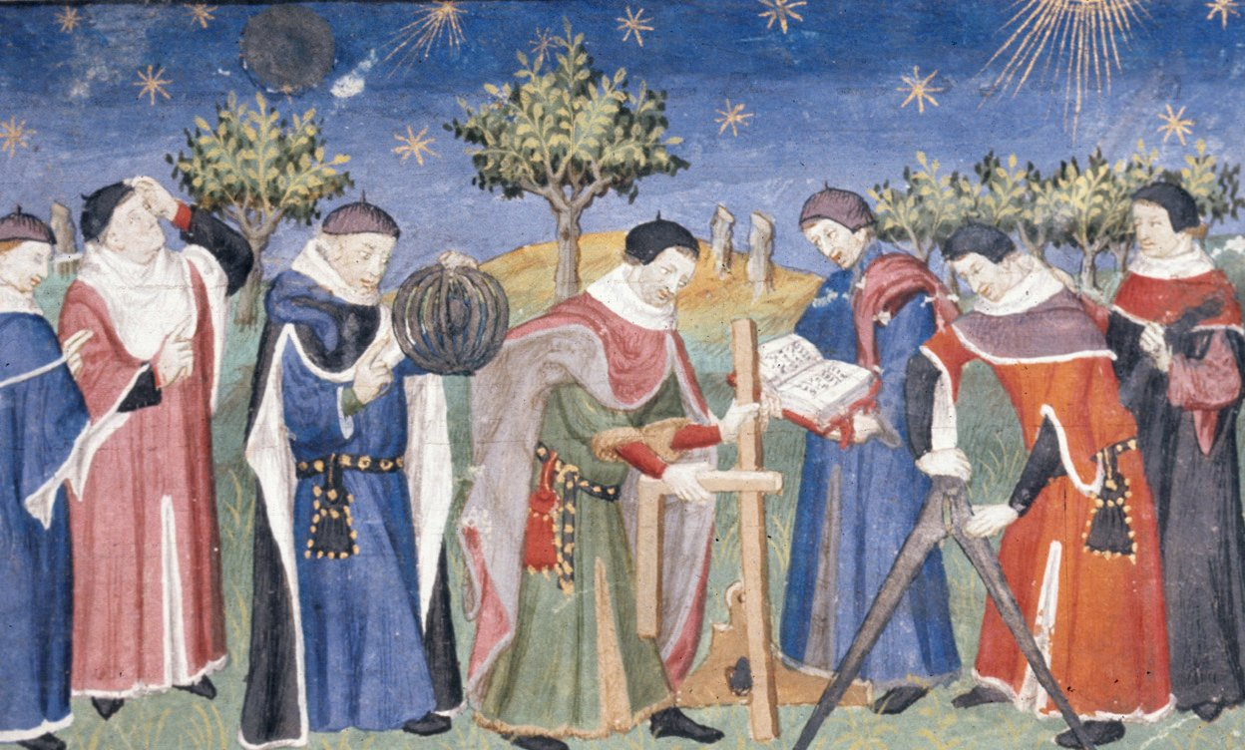
#4 Emergence of New Ideas
From around the late 13th century, new ideas started to change people’s beliefs about the world and their place in it. They challenged existing beliefs – the teachings of the Church that were the dominant influence on society in medieval Europe.

Slide 45
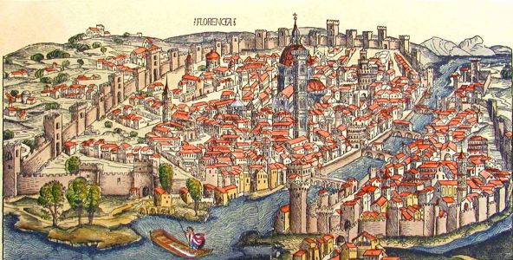
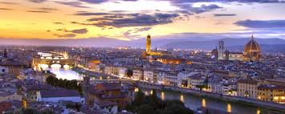
Renaissance
An important intellectual and cultural movement that began in Italy in the late 14th century and spread to the rest of Europe.
Renaissance is French for rebirth- because is involved a ‘rebirth’ of many of the ideas of the Ancient Greeks and Romans. It emphasised philosophy, architecture and art.

Slide 46
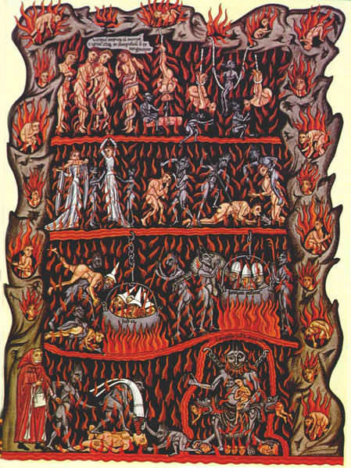
Renaissance
Based on Humanism – which emphasised human actions, achievements and responsibilities, This contrasted with the way people had previously viewed their lives, as a preparation for reaching heaven. The Church had taught people that if they did not follow Church teaching and rule, they would not go to heaven. Humanism challenged this.

Slide 47
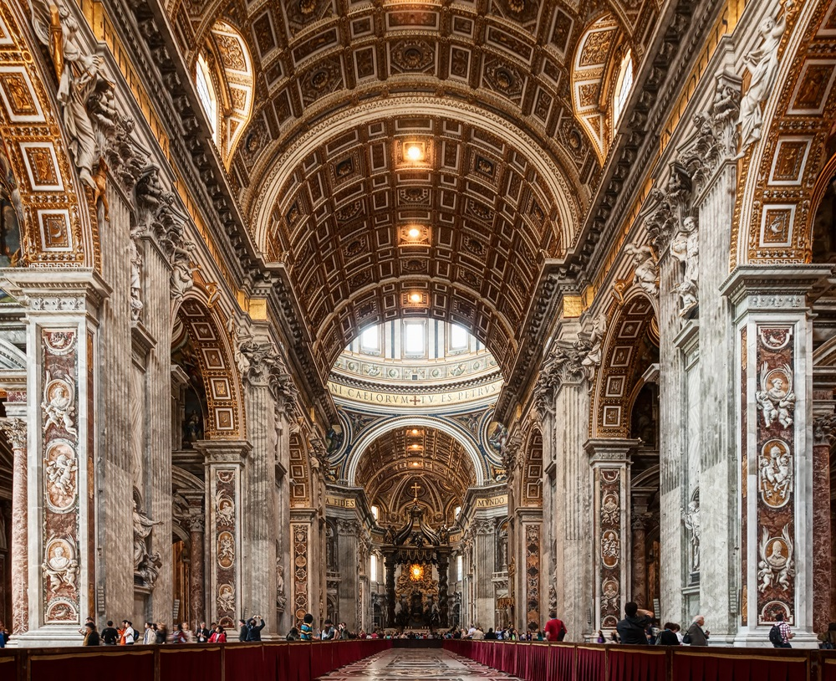
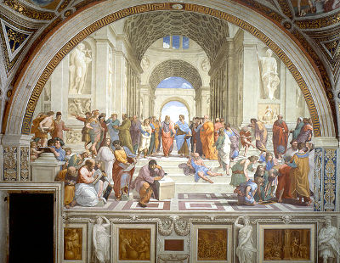
Renaissance
Artists began to develop perspective in painting, so that flat images looked as if they were three-dimensional; architects started to experiment with the forms of Ancient Greece and Rome in their building designs

Slide 48
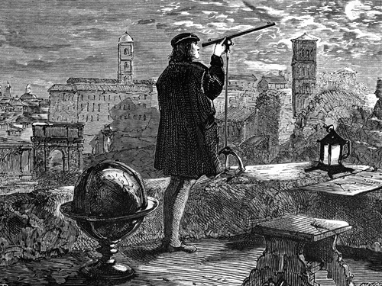
Scientific Revolution
Towards the end of the fifteenth century, scientific method began to break away from the older scientific traditions established by Ancient Greek and Arab scholars, in favour of observation and experimentation to prove scientific theories. Within a few hundred years, scientists’ knowledge of astronomy, biology, chemistry and physics had changed dramatically.

Slide 49
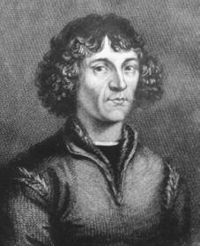
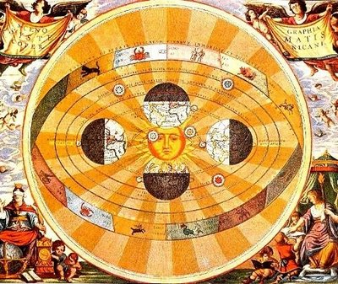
Scientific Revolution
In the early 1500s, the Polish scholar Nicolaus Copernicus used mathematical theory to show that the Sun (not the Earth) was at the centre of the universe, and that the Earth rotated on its axis once every day, and around the Sun once a year.

Slide 50
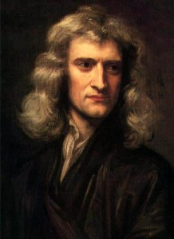
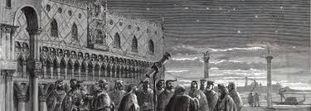
Scientific Revolution
A century later, the Italian astronomer Galileo Galilei built a telescope that enabled him to look at the stars. His careful experimental work showed that other planets were similar to ours.
Isaac Newton, in England in the late 1600s, showed that the force of gravity exists in all material objects, and established the universal law of gravity.

Slide 51
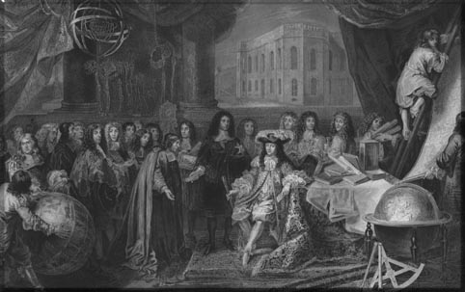
Scientific Revolution
While some historians describe the changes in scientific method as a ‘revolution’, it was actually a more gradual advance that was built on centuries of medieval science.

Slide 52

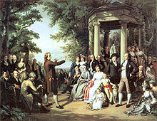
The Enlightenment
The Enlightenment was an important philosophical movement in the Early Modern Period ( 1620- 1780’s). According to Enlightenment thought, reason and science (rather than tradition or religion) should be the basis for making decisions.

Slide 53
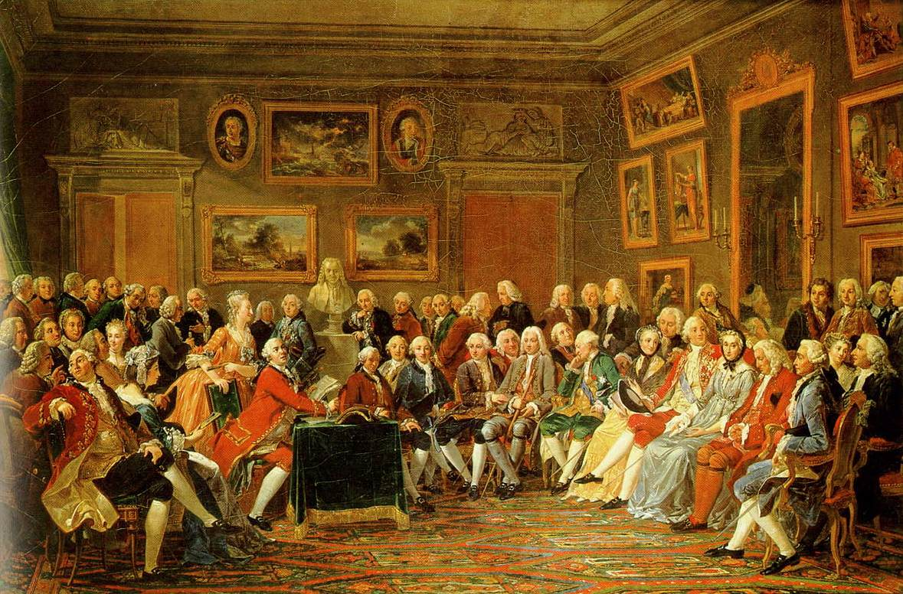
The Enlightenment
The Enlightenment also introduced new ideas about freedom and human rights — some of which had been slowly developing since the late Medieval Period.
These freedoms and rights were to be available to all people, regardless of the social class into which a person had been born. In theory at least, the life of a peasant was worth the same as that of a king.

Slide 54
Student Task:
Research an invention from one of the time periods. Present your findings in a report, PowerPoint or PowToon.
Include:
a description of the invention
Identify who was responsible and when
Outline the changes the invention had on society

